Slide 1
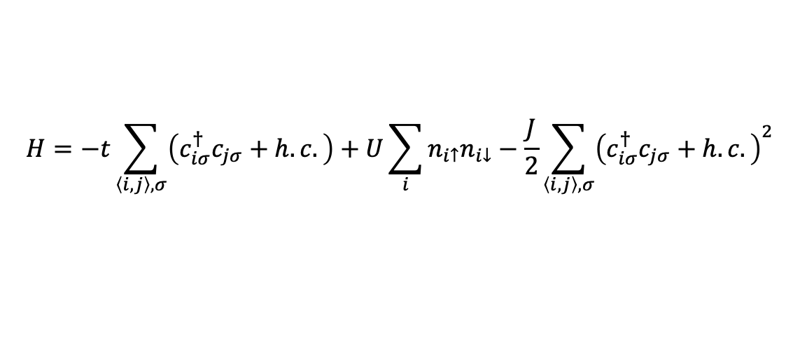
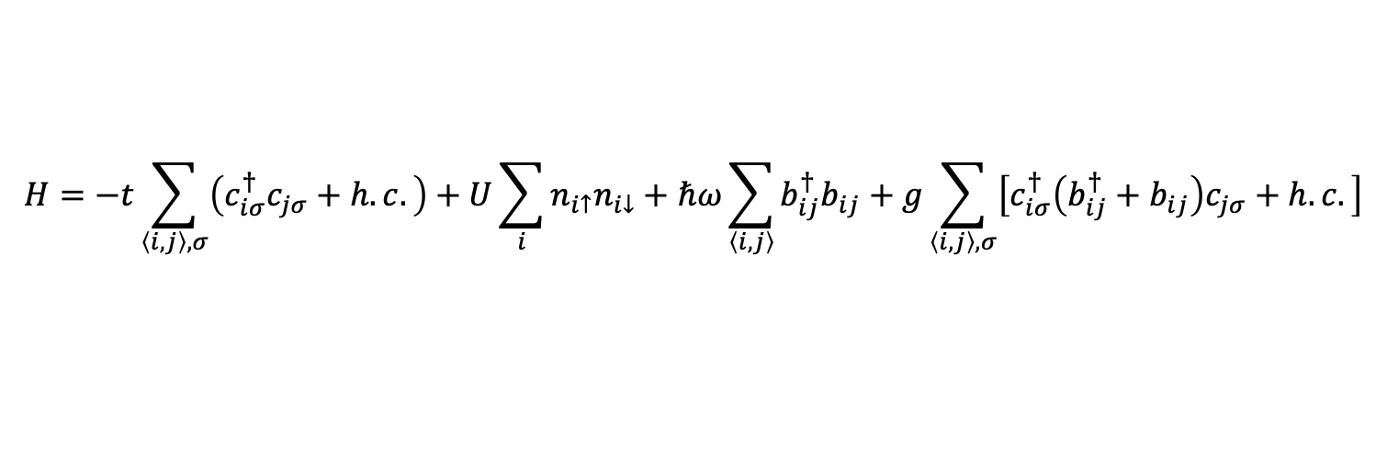
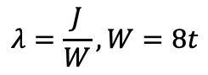
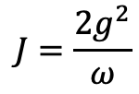
SSH-Hubbard model
$$H=−t\sum_{\left\langle i,j\right\rangle ,σ}{\left(c_{iσ}^{†}c_{jσ}+h.c.\right)}+U\sum_{i}{n_{i↑}n_{i↓}}+ℏω\sum_{\left\langle i, j\right\rangle }{b_{ij}^{†}b_{ij}}+g\sum_{\left\langle i, j\right\rangle ,σ}{\left[c_{iσ}^{†}\left(b_{ij}^{†}+b_{ij}\right)c_{jσ}+h.c.\right]}$$
$$H=−t\sum_{\left\langle i,j\right\rangle ,σ}{\left(c_{iσ}^{†}c_{jσ}+h.c.\right)}+U\sum_{i}{n_{i↑}n_{i↓}}−\frac{J}{2}\sum_{\left\langle i,j\right\rangle ,σ}{{\left(c_{iσ}^{†}c_{jσ}+h.c.\right)}^{2}}$$
$$J=\frac{2g^{2}}{ω}$$
$$λ=\frac{J}{W}, W=8t$$

Slide 2
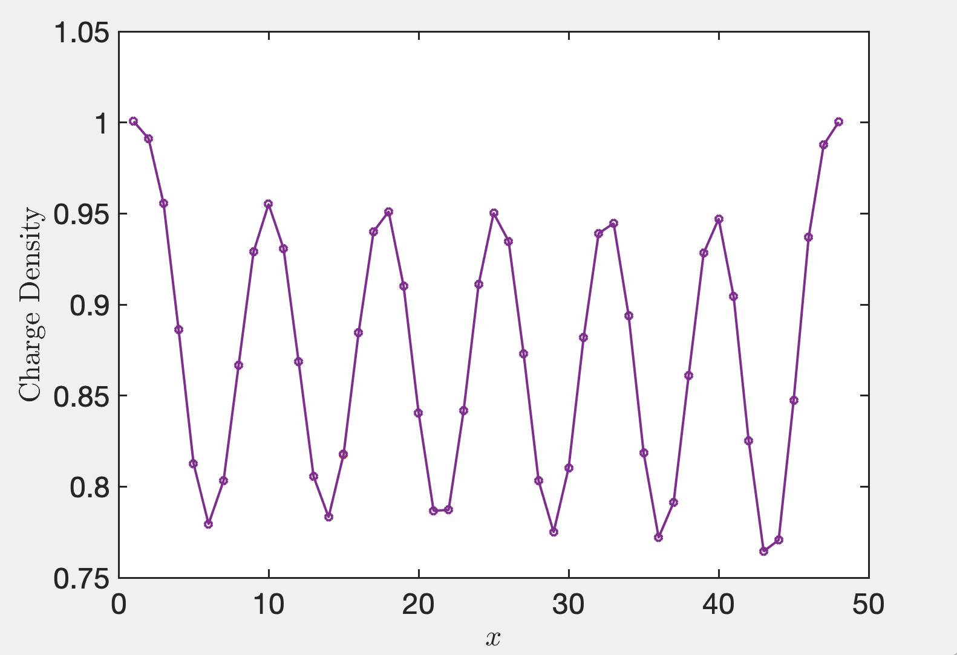
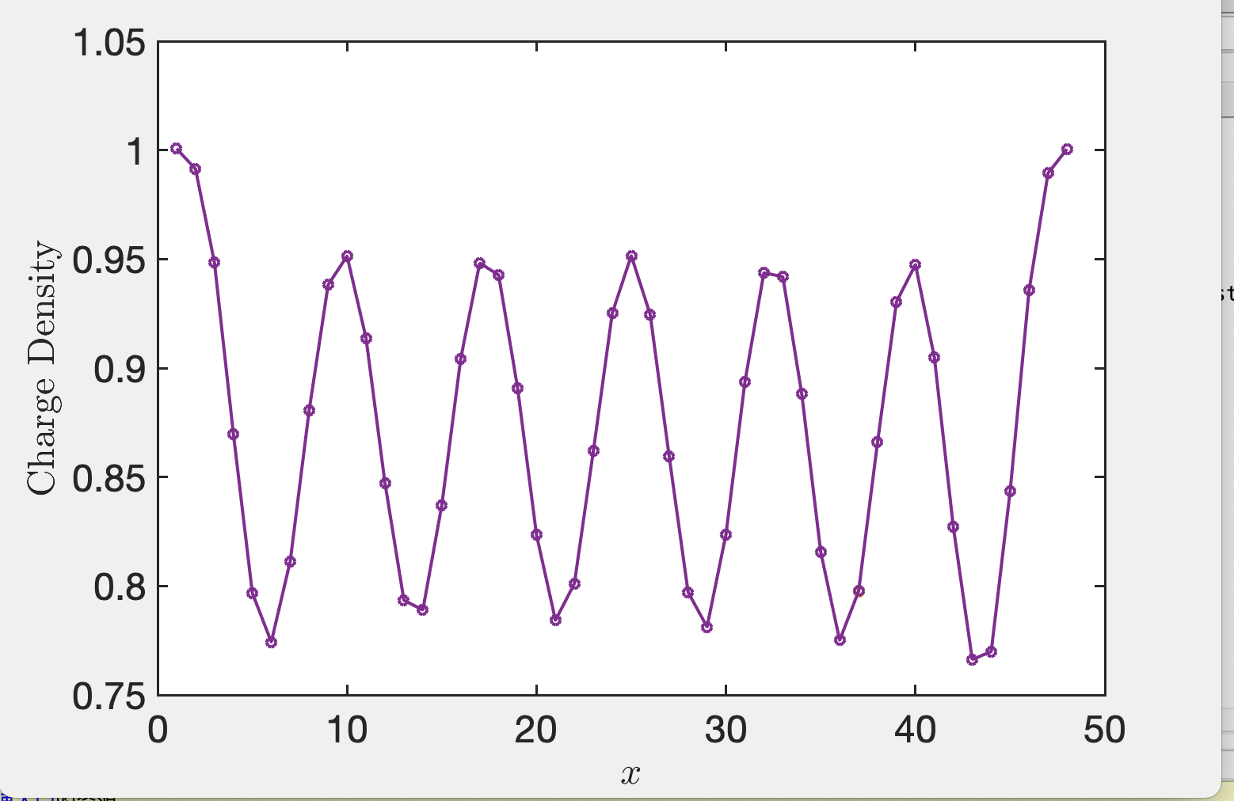
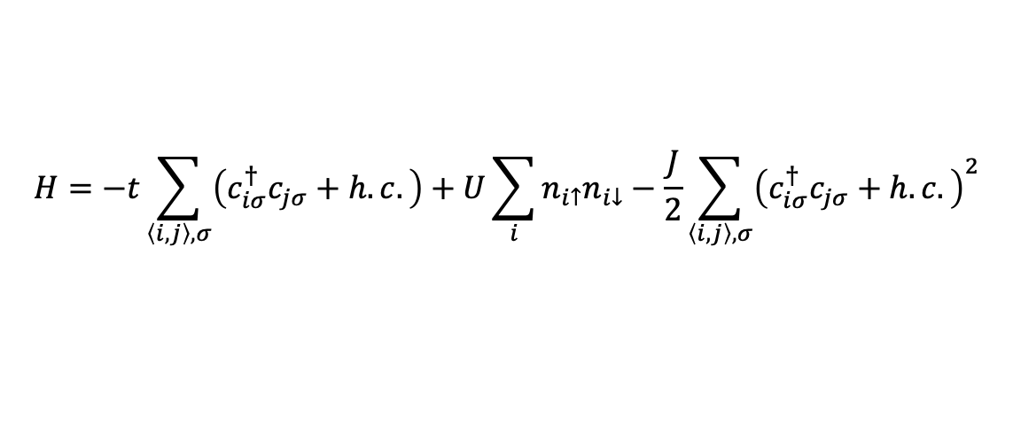
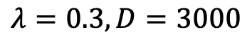
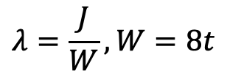
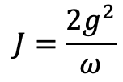
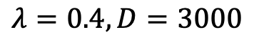
Effective fermionic model at anti-adiabatic limit $ω_{D}→∞$
$$H=−t\sum_{\left\langle i,j\right\rangle ,σ}{\left(c_{iσ}^{†}c_{jσ}+h.c.\right)}+U\sum_{i}{n_{i↑}n_{i↓}}−\frac{J}{2}\sum_{\left\langle i,j\right\rangle ,σ}{{\left(c_{iσ}^{†}c_{jσ}+h.c.\right)}^{2}}$$
$$J=\frac{2g^{2}}{ω}$$
$$λ=\frac{J}{W}, W=8t$$
$$λ=0.3, D=3000$$
$$λ=0.4, D=3000$$

Slide 3
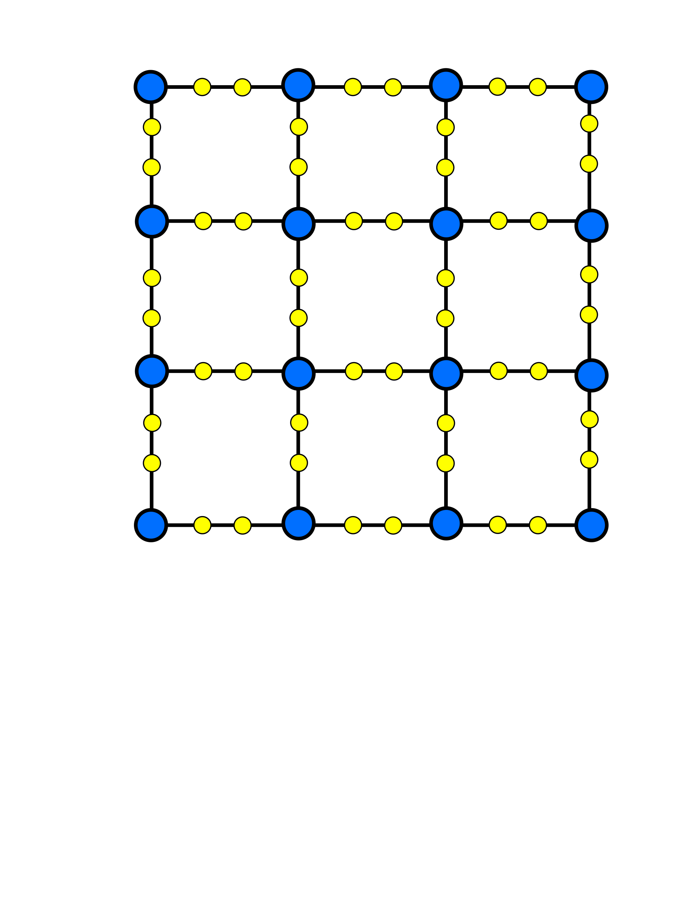
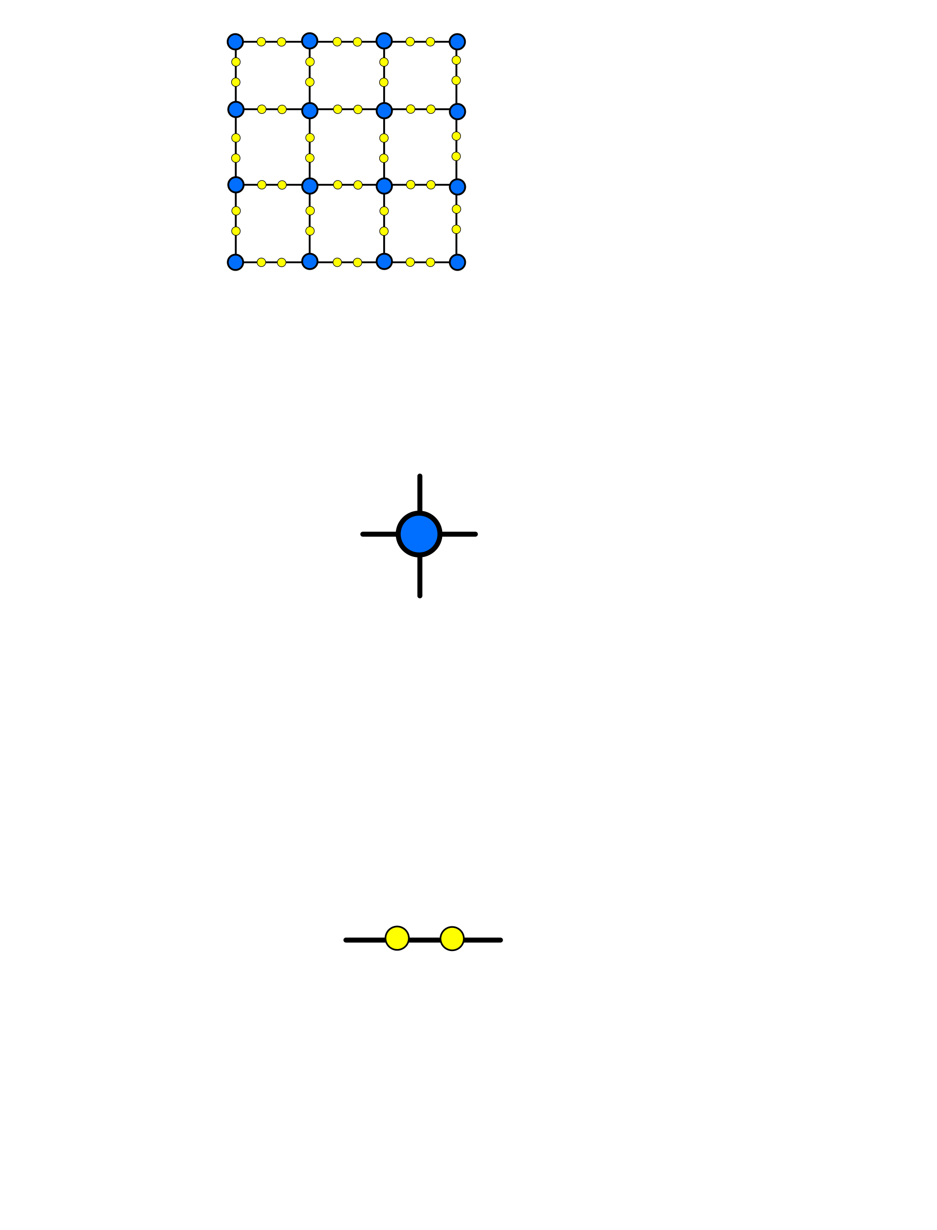
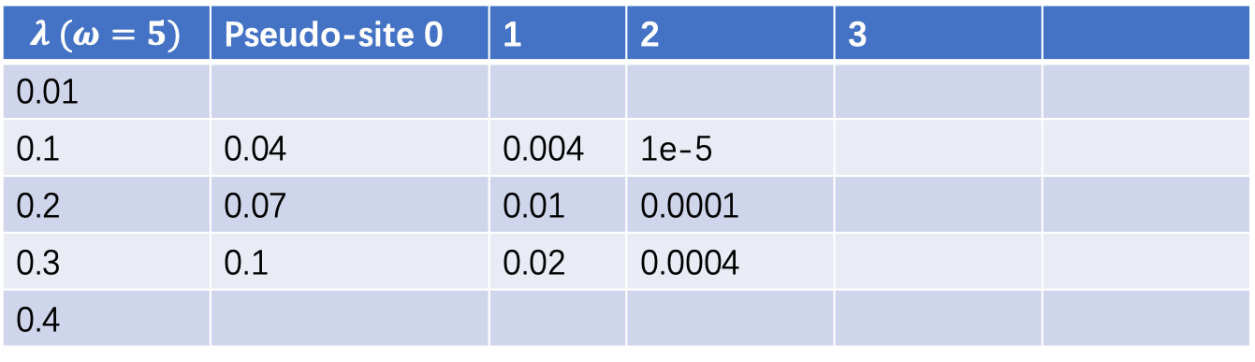
Phonon pseudo-site
PhysRevB.57.6376
$$λ (ω=5)$$ | Pseudo-site 0 | 1 | 2 | 3
0.01
0.1 | 0.04 | 0.004 | 1e-5
0.2 | 0.07 | 0.01 | 0.0001
0.3 | 0.1 | 0.02 | 0.0004
0.4
Fermionic site
Bosonic pseudo-site

Slide 4
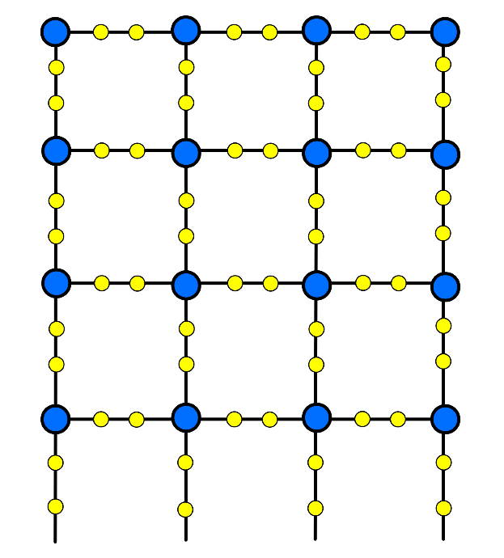
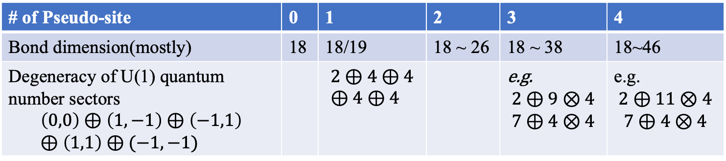
Matrix product operator for SSH-Hubbard model on 4-leg ladder
# of Pseudo-site | 0 | 1 | 2 | 3 | 4
Bond dimension(mostly) | 18 | 18/19 | 18 ~ 26 | 18 ~ 38 | 18~46
Degeneracy of U(1) quantum number sectors $$\left(0,0\right)⊕\left(1,−1\right)⊕\left(−1,1\right)⊕\left(1,1\right)⊕(−1,−1)$$ |  | $$2⊕4⊕4⊕4⊕4$$ |  | e.g. $$2⊕9⊗4$$ $$7⊕4⊗4$$ | e.g. $$2⊕11⊗4$$ $$7⊕4⊗4$$

Slide 5
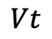

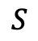
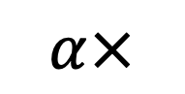
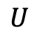


Algorithm: single site update
$$α×$$
$$=$$
Lanczos
Find the noise term
$$⨁$$
$$=$$
$$U$$
$$S$$
$$Vt$$
expansion
Svd and truncate

Slide 6
Algorithm: single site update
Advantage:
Accelerating on Lanczos
Fast increasing bond dimension
Disadvantage
Efficiencies are suffered by fuse index, expansion and SVD, since MPO bond dimension is to large
Difficult to converge(?)

Slide 7

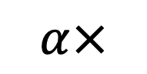


Algorithm: expanded two site update
$$α×$$
$$=$$
Lanczos
Find the noise term
$$\sim$$
$$⨁$$
$$=$$
$$U$$
$$S$$
$$Vt$$
Only expand new quantum sector on the right hand side bond
Svd and truncate

Slide 8
Algorithm: expanded two site update
Advantage:
Also some gains when increasing bond dimension
More robust to overcome local minimum(?)
SVD time is normal, most time is used on Lanczos
Disadvantage
Also difficult to converge(?)
When update the last pseudo-site phonon & fermion sites, the degeneracy on every quantum number sector is hardly to increase.
So, one strategy is using not sufficient phonon pseudo-site number, if the physics does not change.

Slide 9
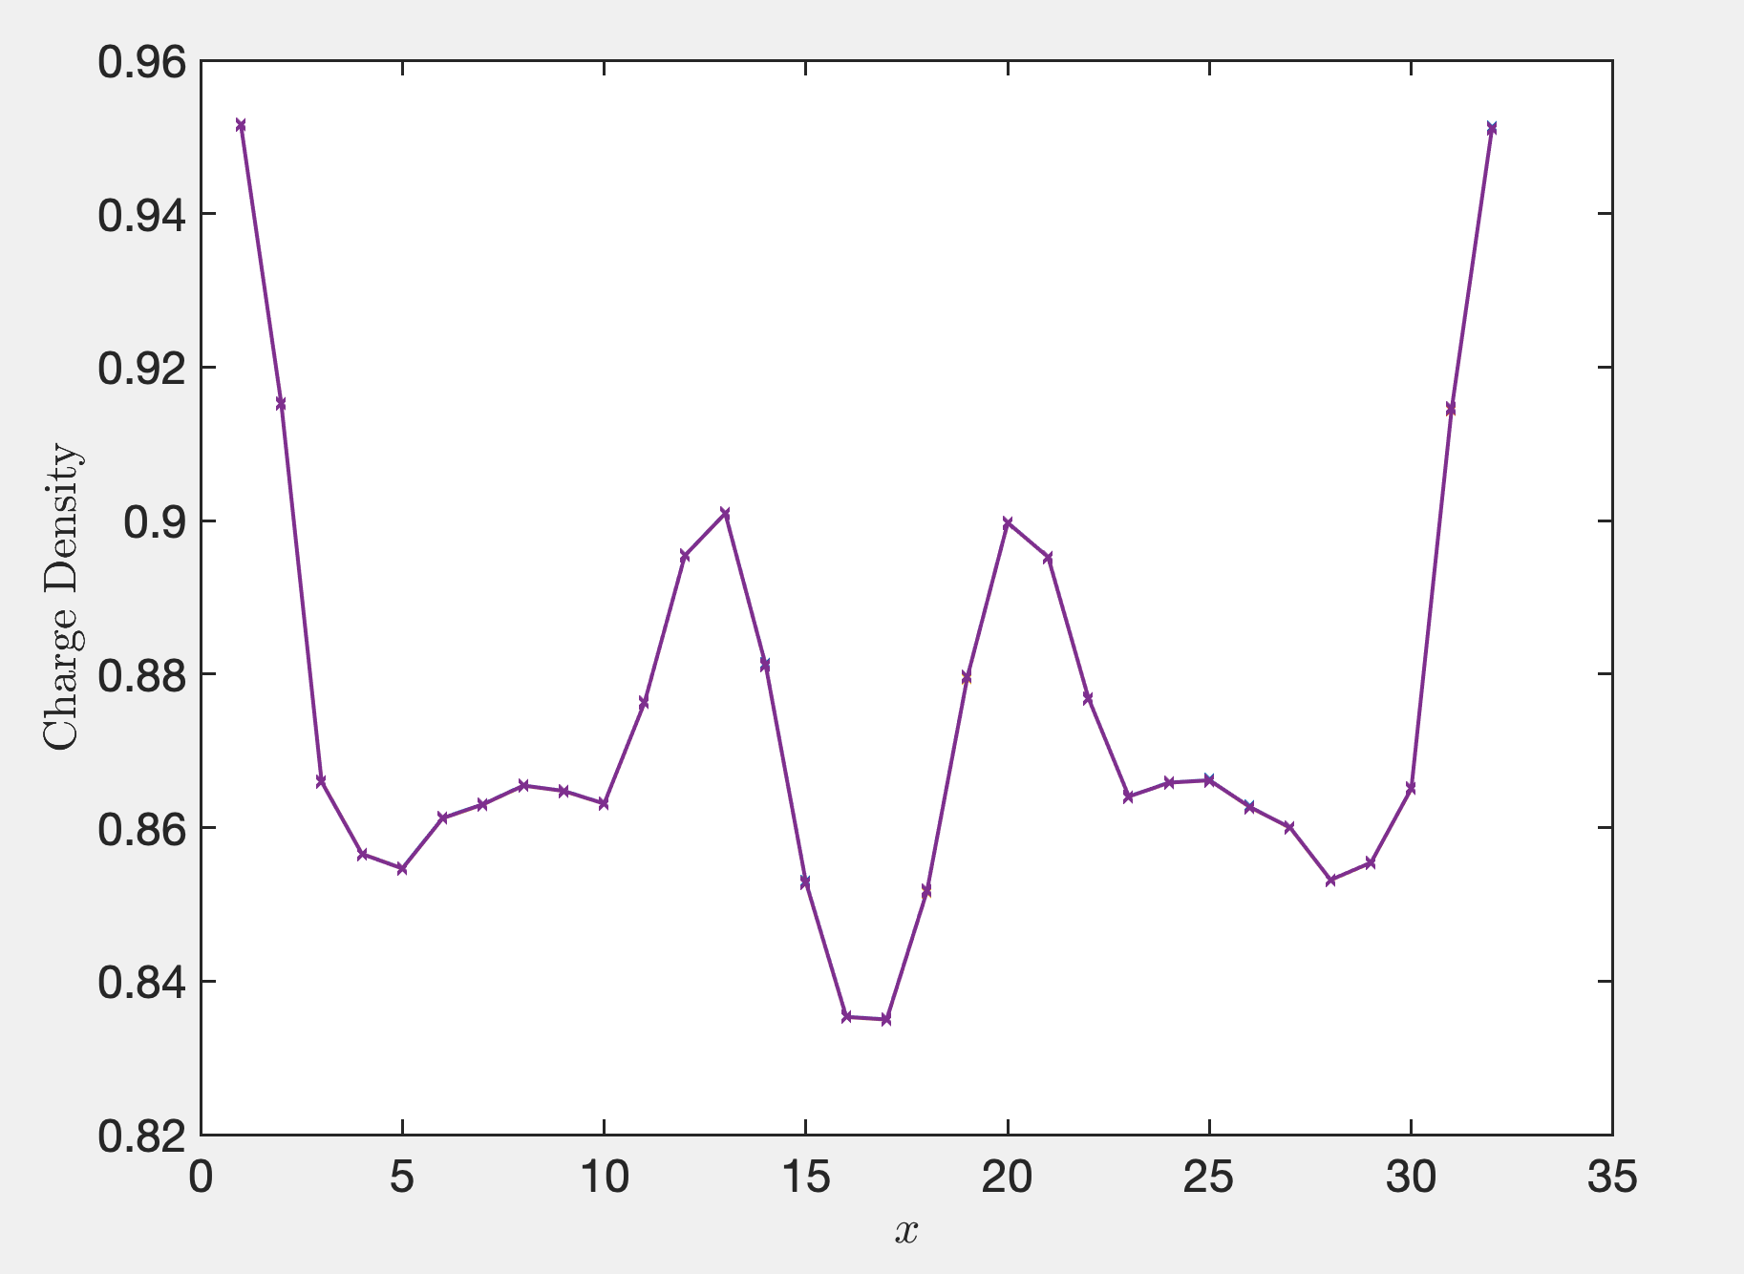
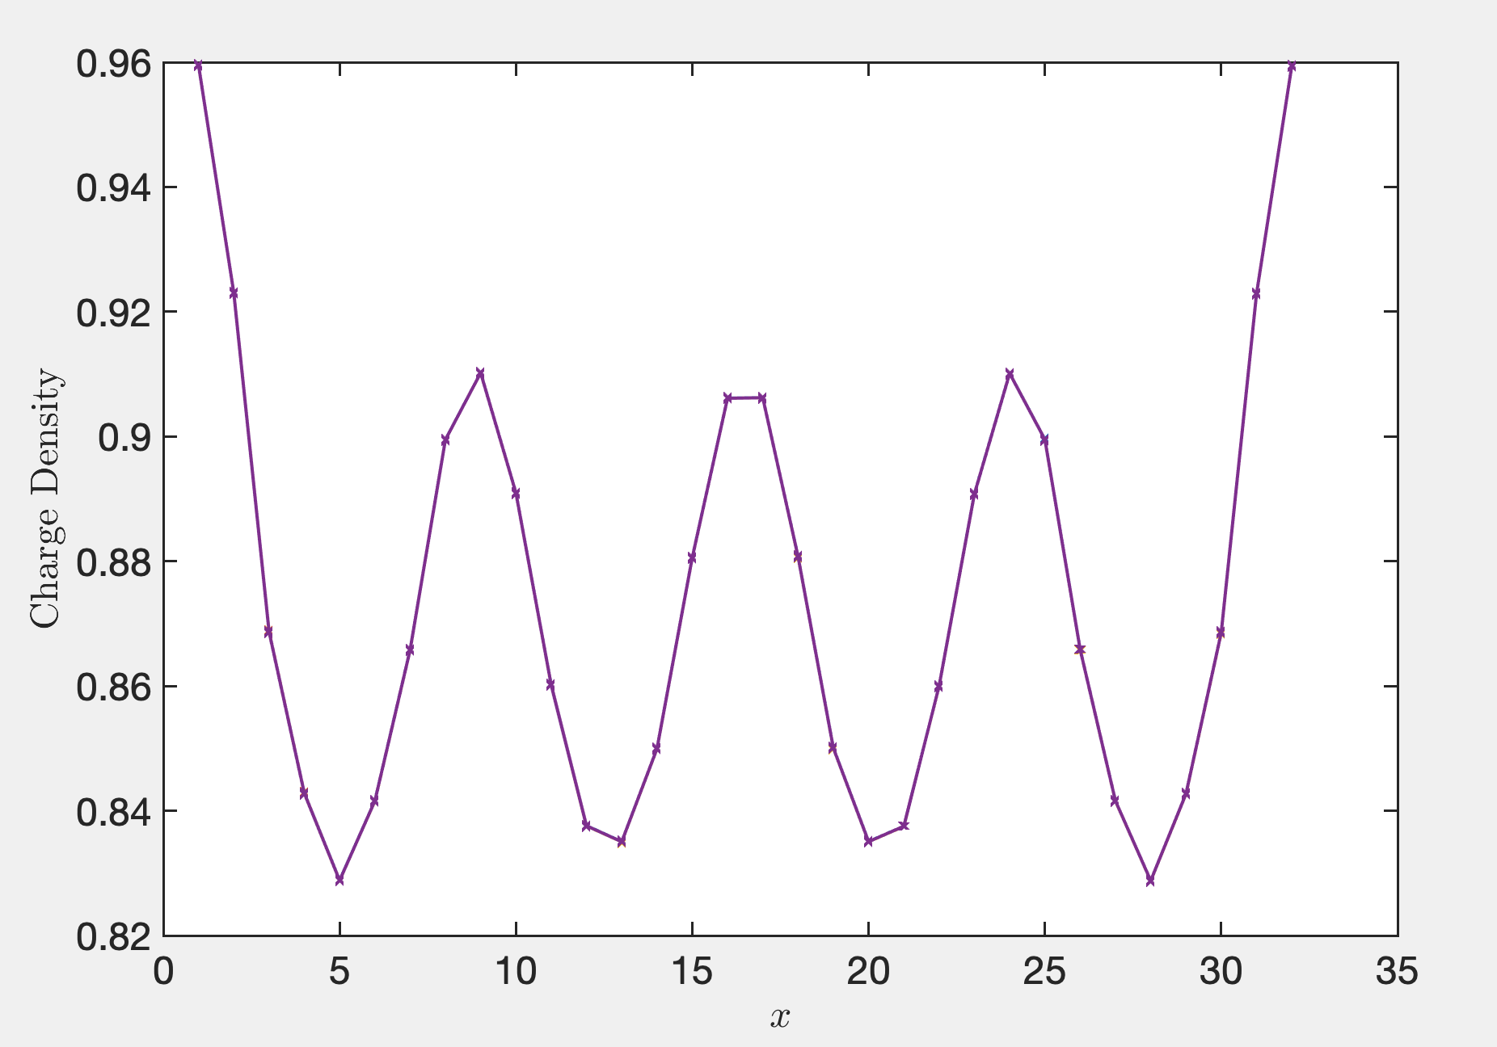
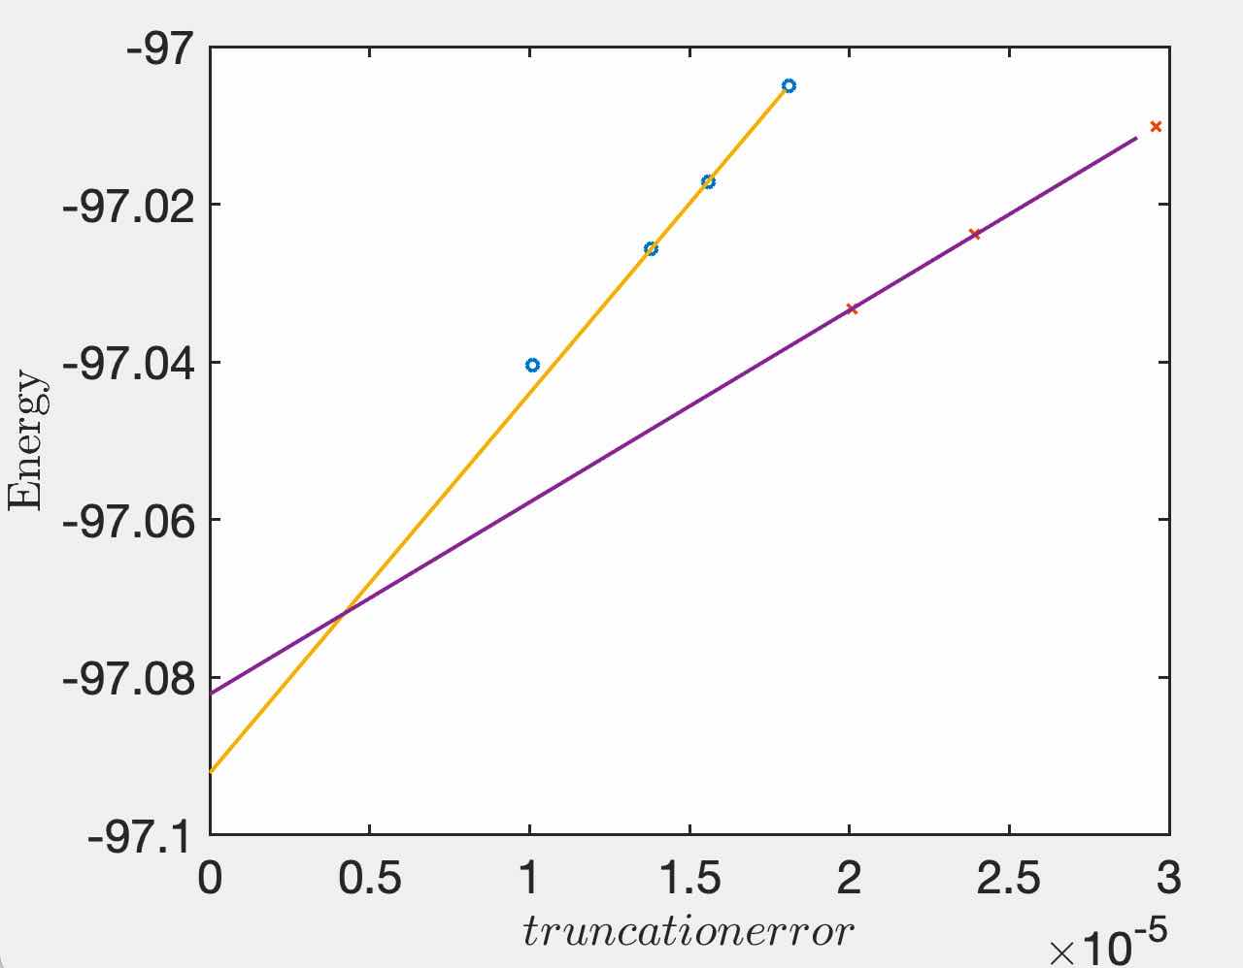
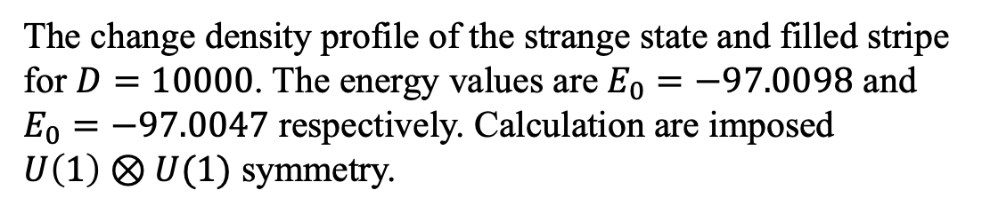
Test/benchmark: Hubbard model on $4×32$ lattice
Ground state of 1/8 dopped Hubbard model on $4×32$ lattice should be filled-stripe, but on finite bond dimension $D$, the lowest energy state is some strange state.
The change density profile of the strange state and filled stripe for $D=10000$. The energy values are $E_{0}=−97.0098$ and $E_{0}=−97.0047$ respectively. Calculation are imposed $U\left(1\right)⊗U(1)$ symmetry.
Energy values v.s. truncation error and extrapolations. Filled stripe finally have more lower energy.

Slide 10
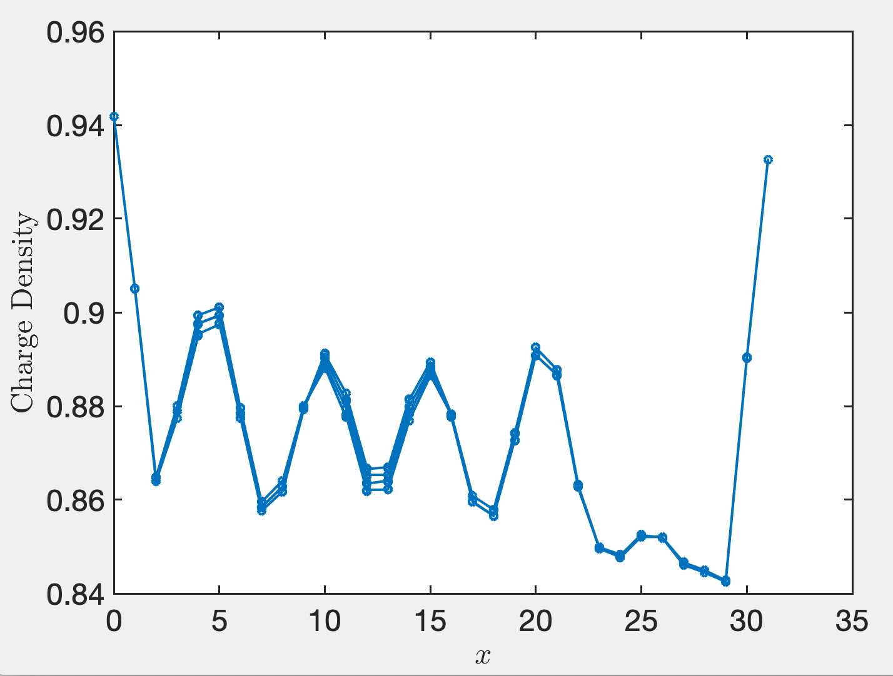
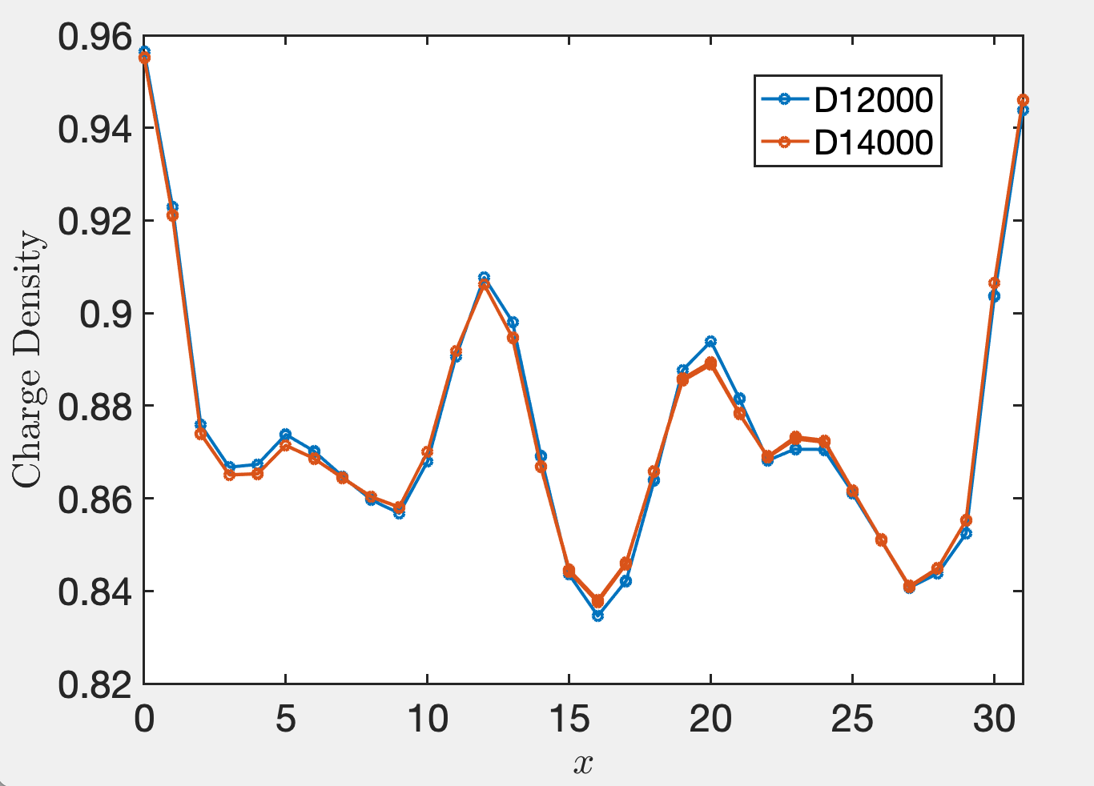
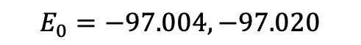
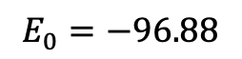
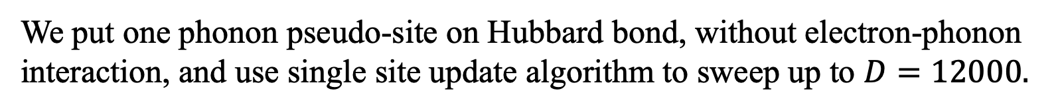
Test/benchmark: Hubbard model on $4×32$ lattice
We put one phonon pseudo-site on Hubbard bond, without electron-phonon interaction, and use single site update algorithm to sweep up to $D=12000.$
Single site update
D=10000
More bond dimensions are needed to get a proper wave function
I aborted this group of calculation on Aug. 28th
$$E_{0}=−96.88$$
$$E_{0}=−97.004, −97.020$$

Slide 11
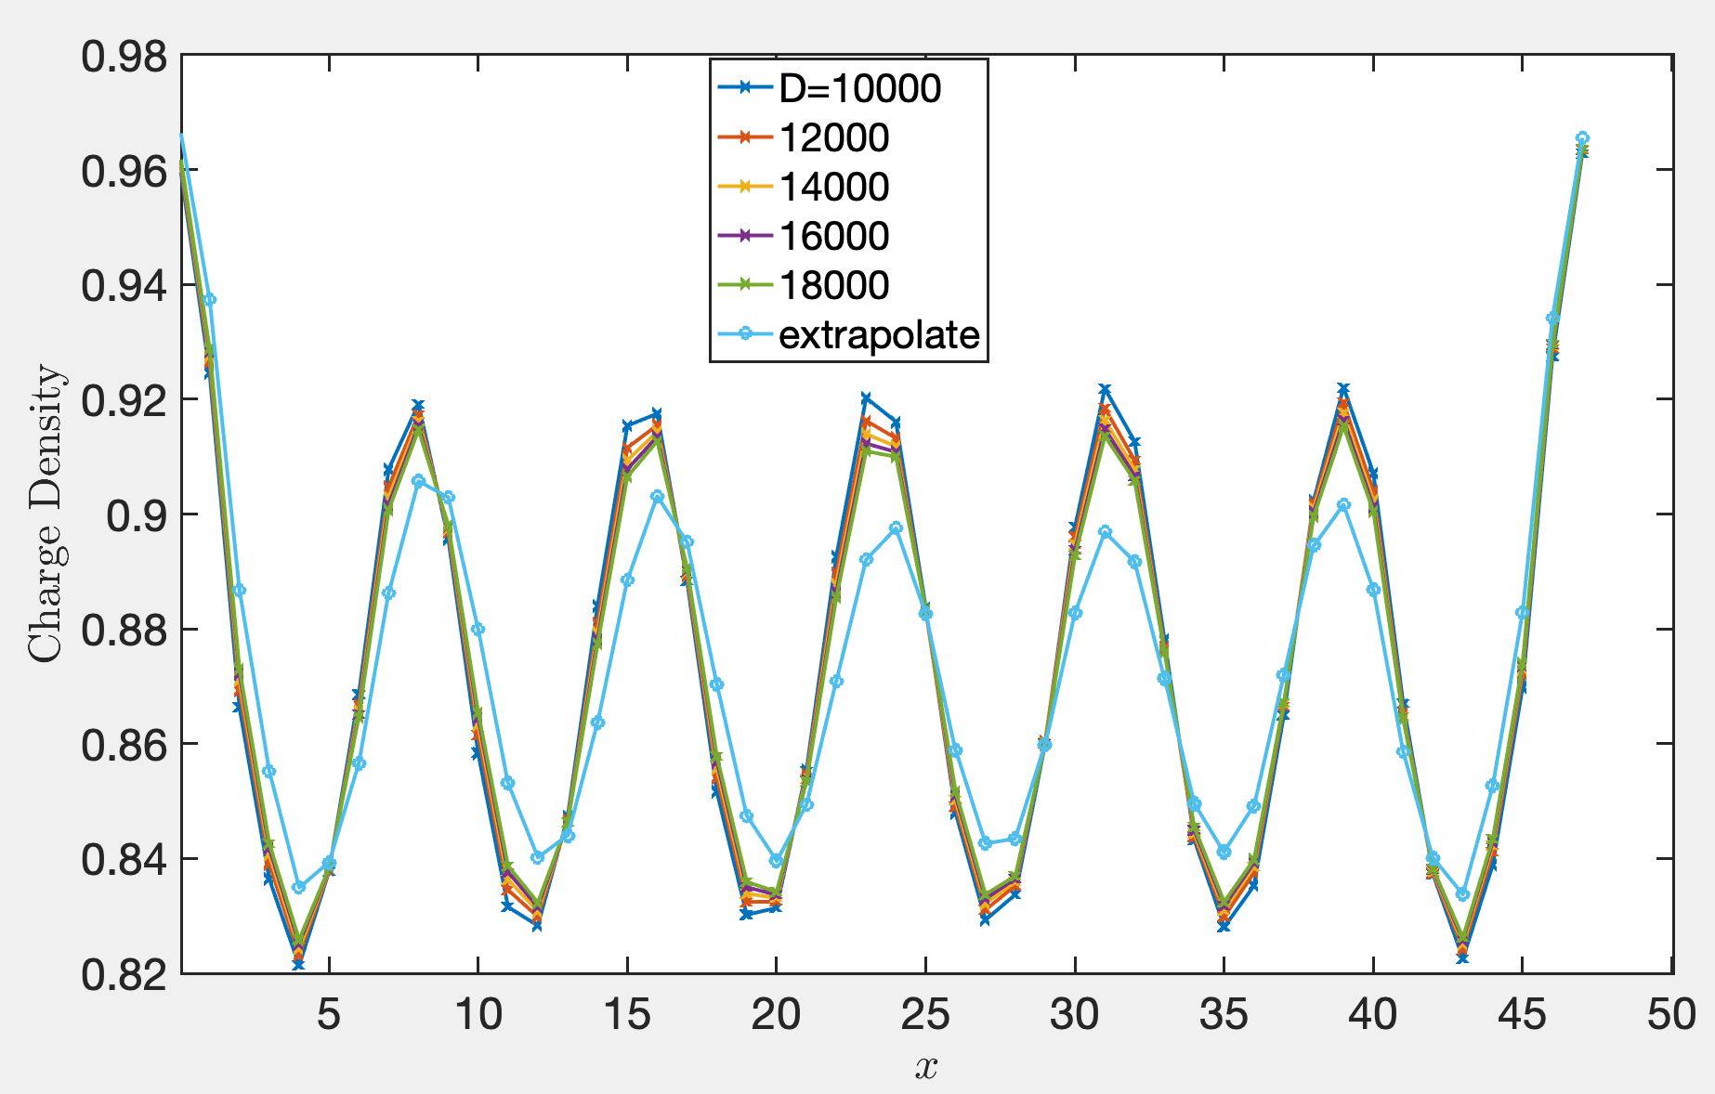
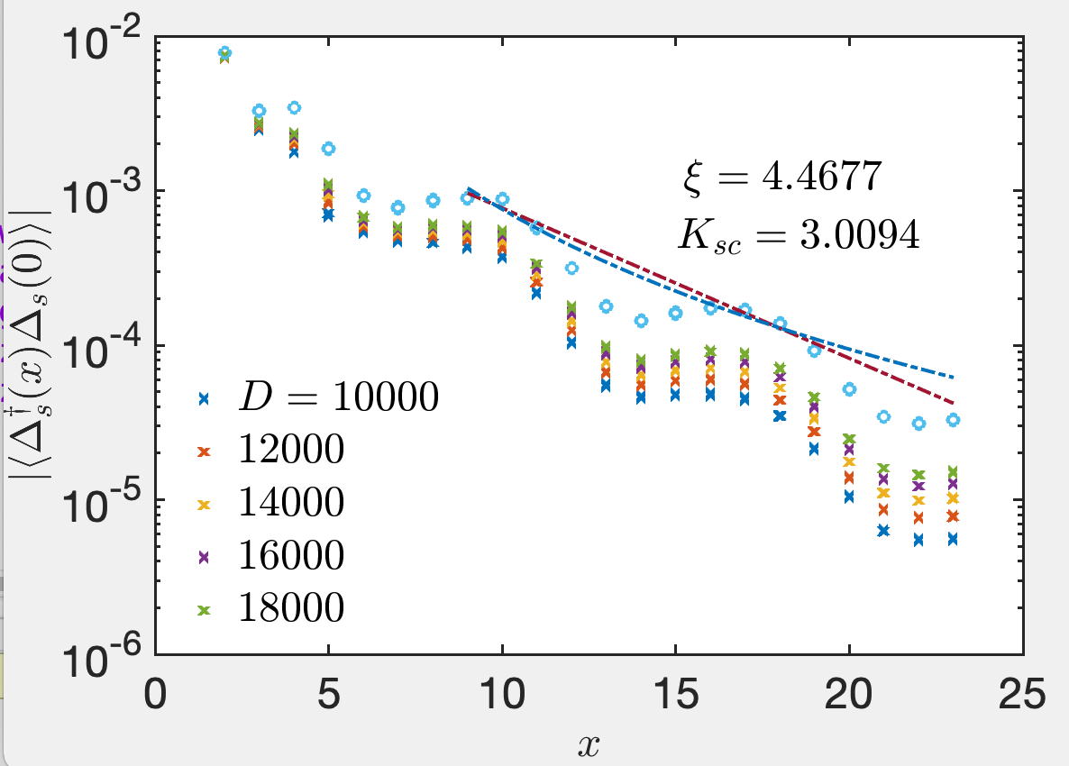
SSH-Hubbard, $λ=0.01, 4×48$, filled-stripe state
$$E_{0}=−159.81, −159.840, −159.860, −159.873,−159.8846$$

Slide 12
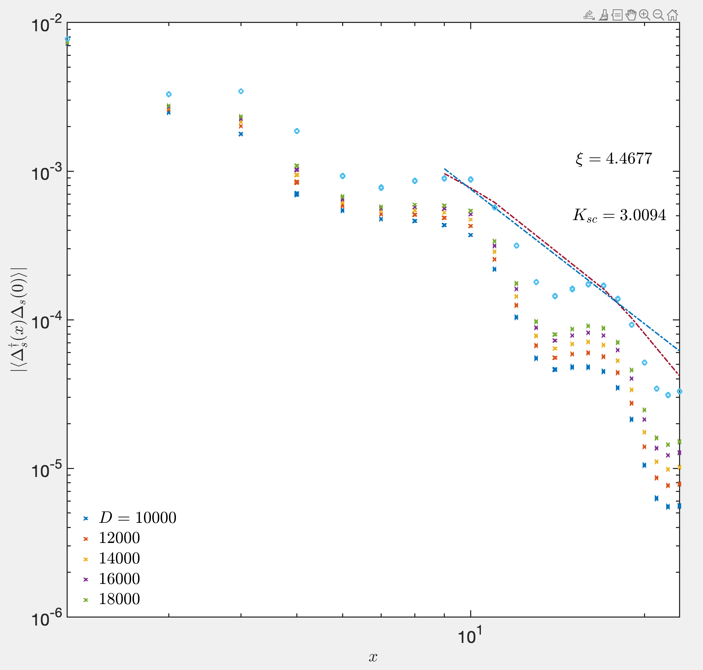

Slide 13
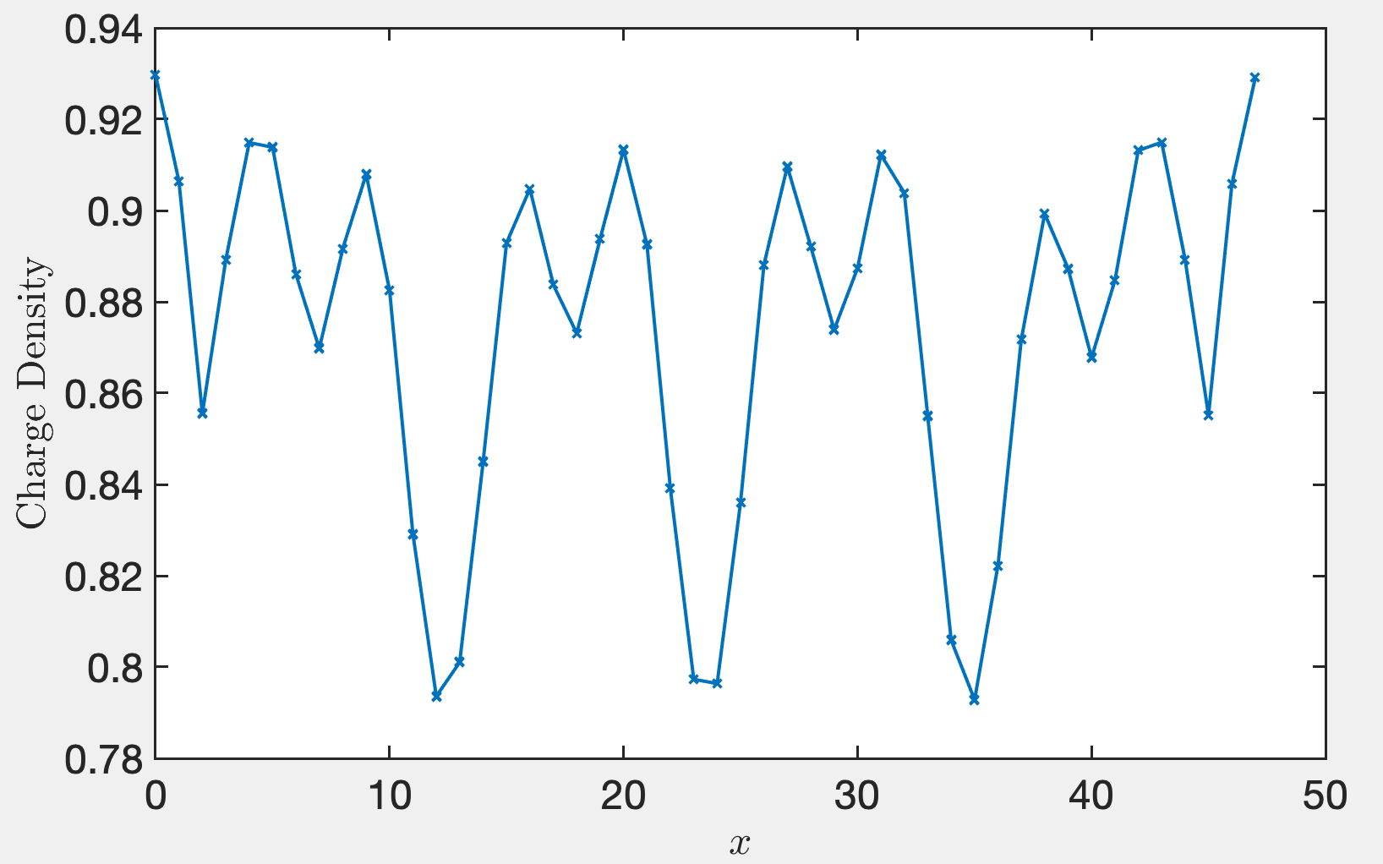
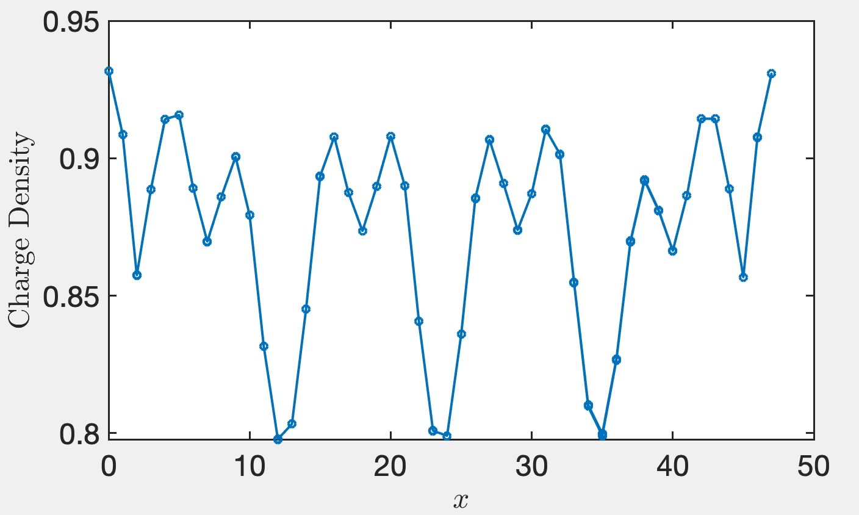
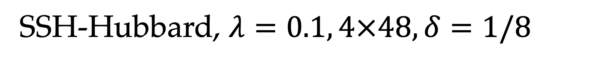
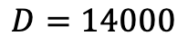
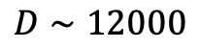
SSH-Hubbard, $λ=0.1, 4×48, δ=1/8$
$$D∼12000$$
$$D=14000$$
Aug. 20
Period = 12(?), 6
Algorithm: two-site update. Charge density almostly converged.

Slide 14
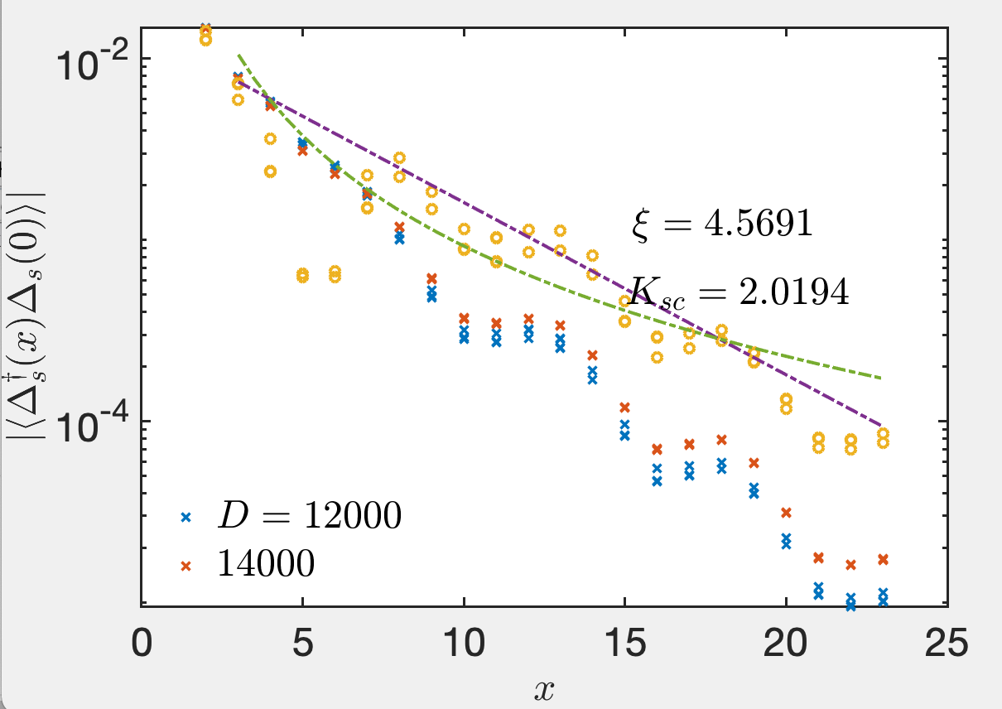
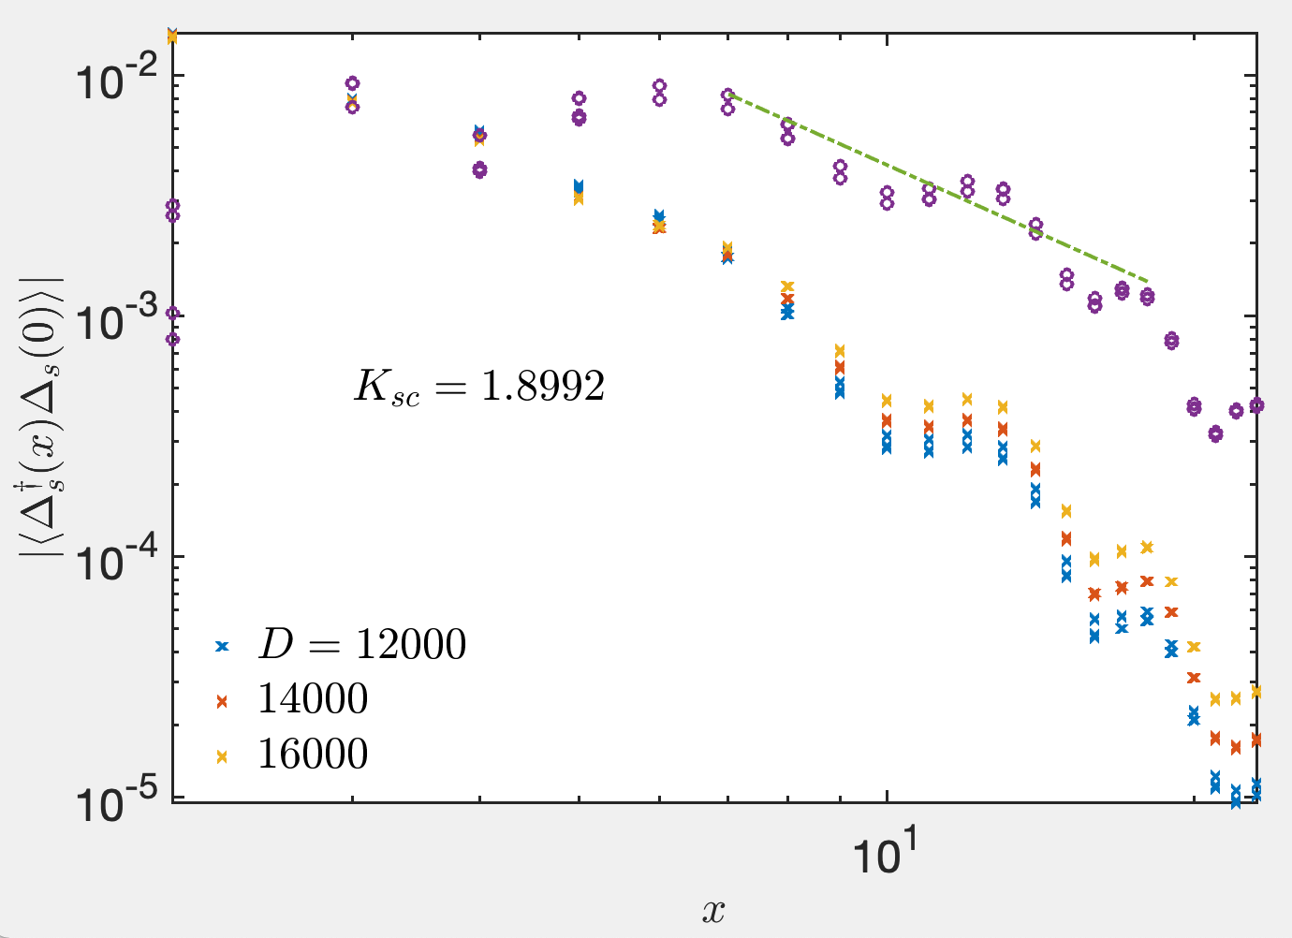

Slide 15
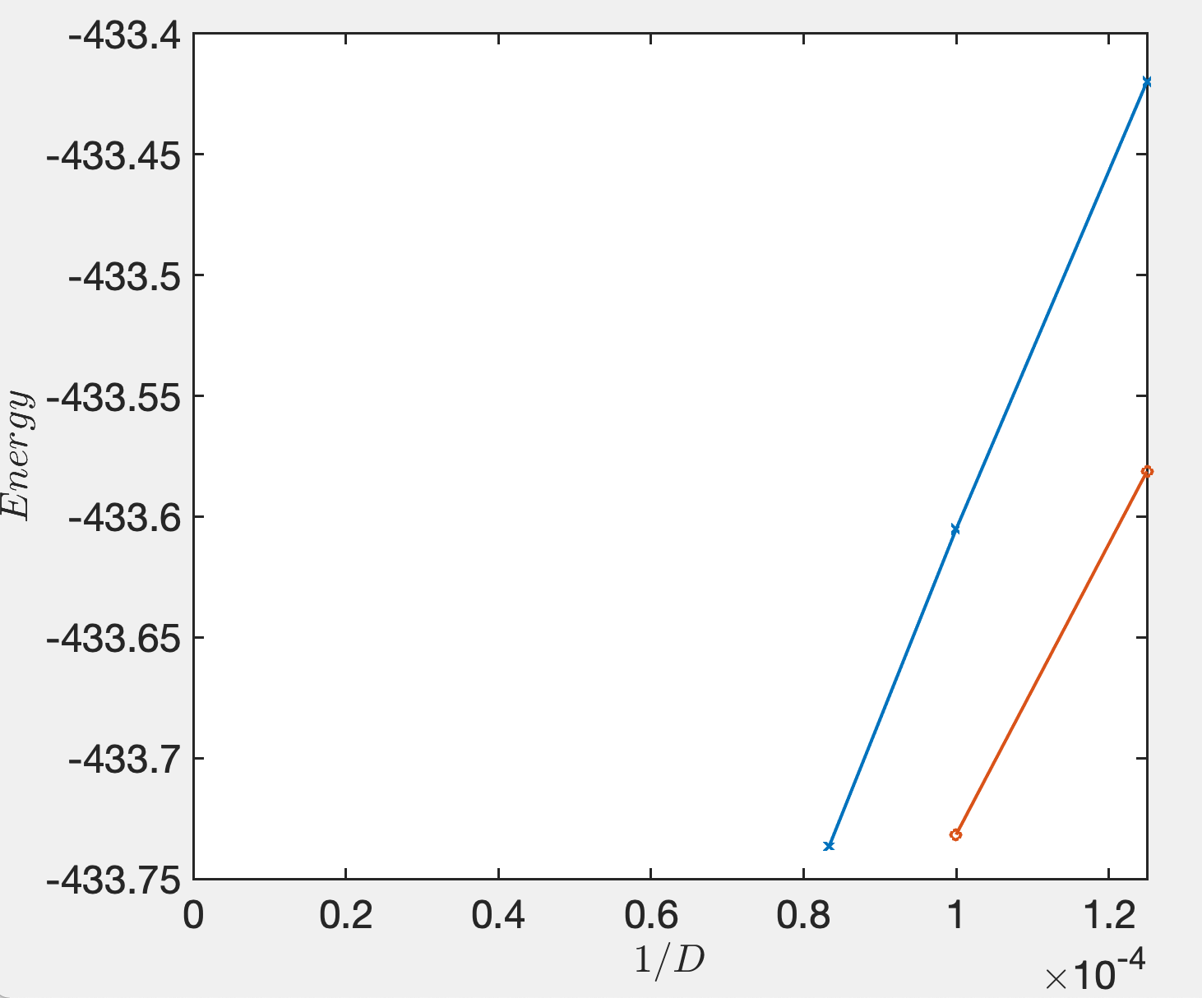
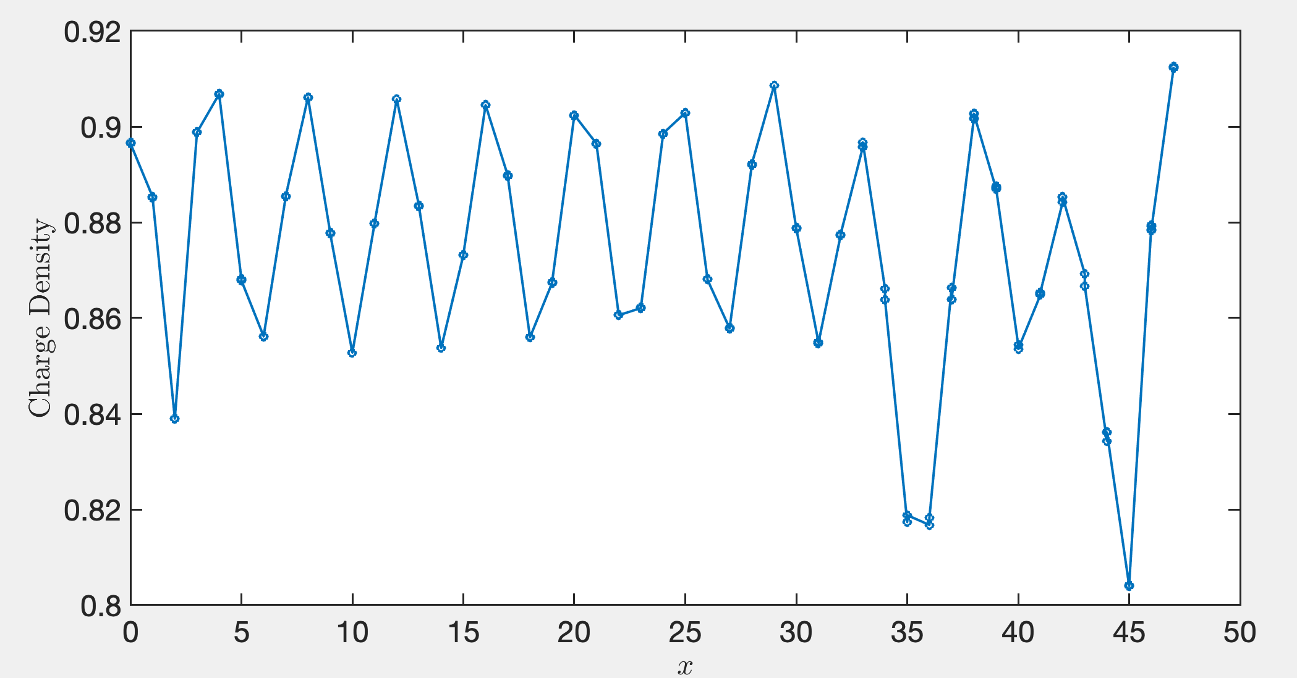
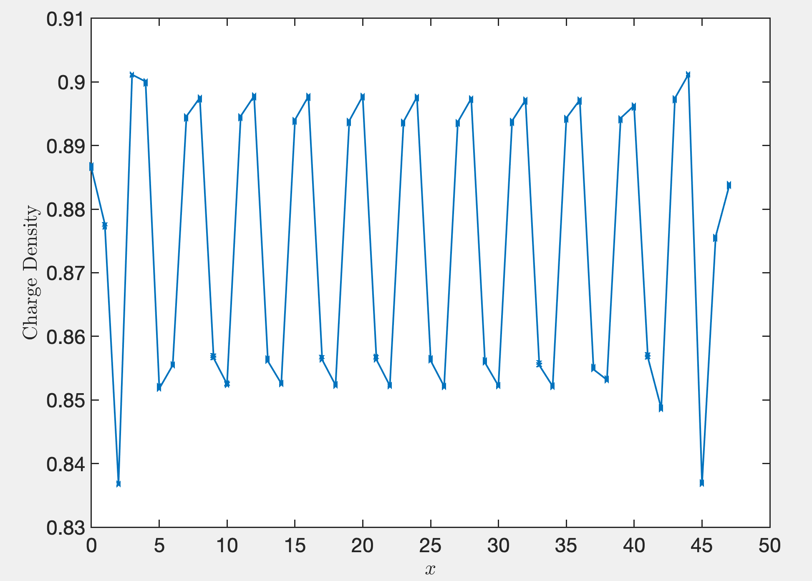
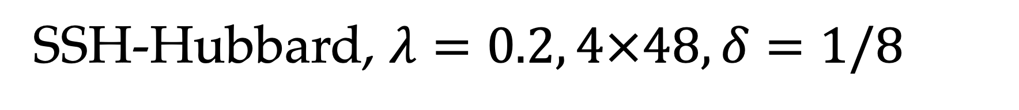
SSH-Hubbard, $λ=0.2, 4×48, δ=1/8$
D=12000, Sep 13nd
Blue is the weird state, red is half-filled stripe. But almost data are not accurate.
D=8000

Slide 16
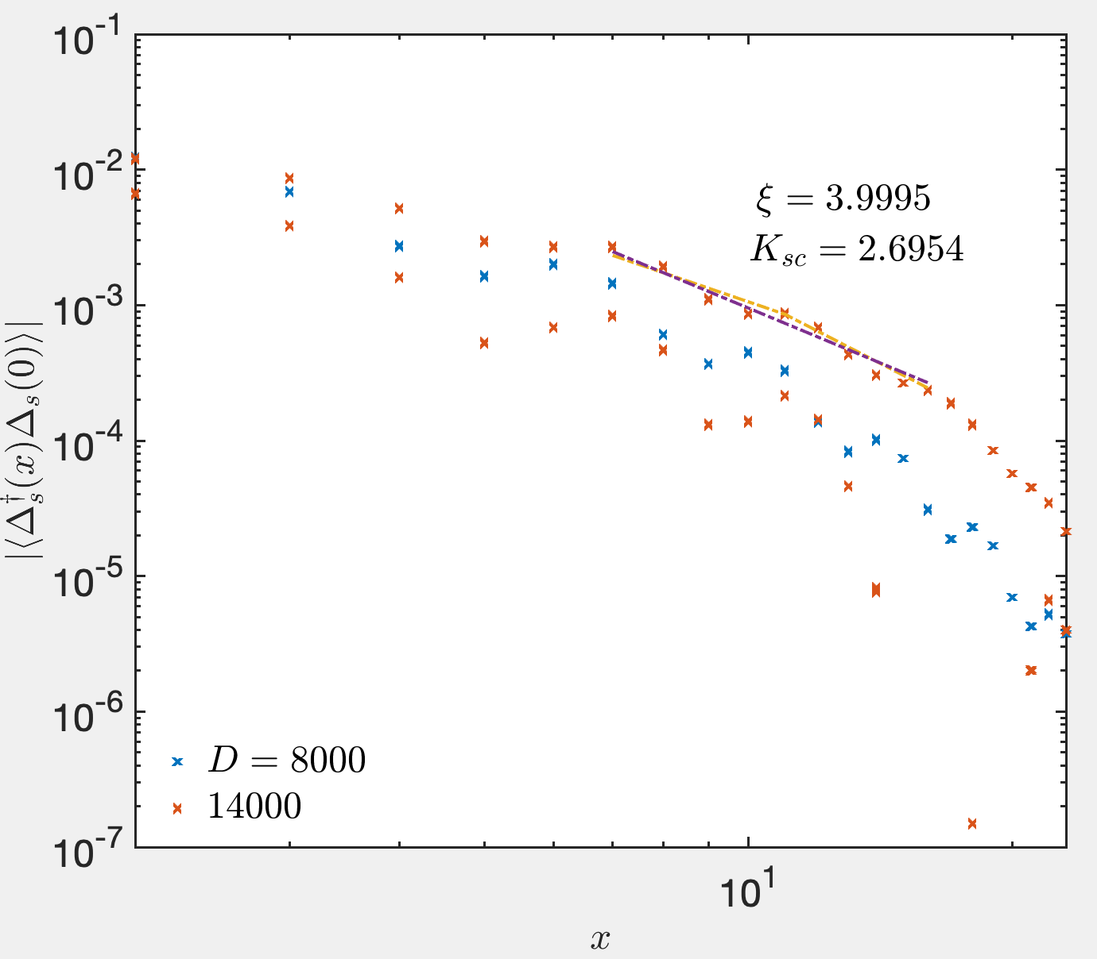
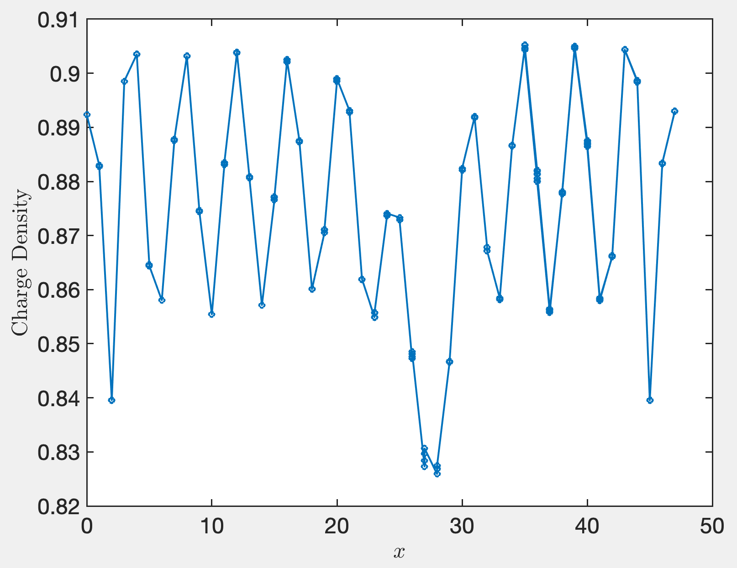
D=14000
Data of D=8000 corresponding to half-filled stripe
Data of D=14000 is the strange state in the left figure.

Slide 17
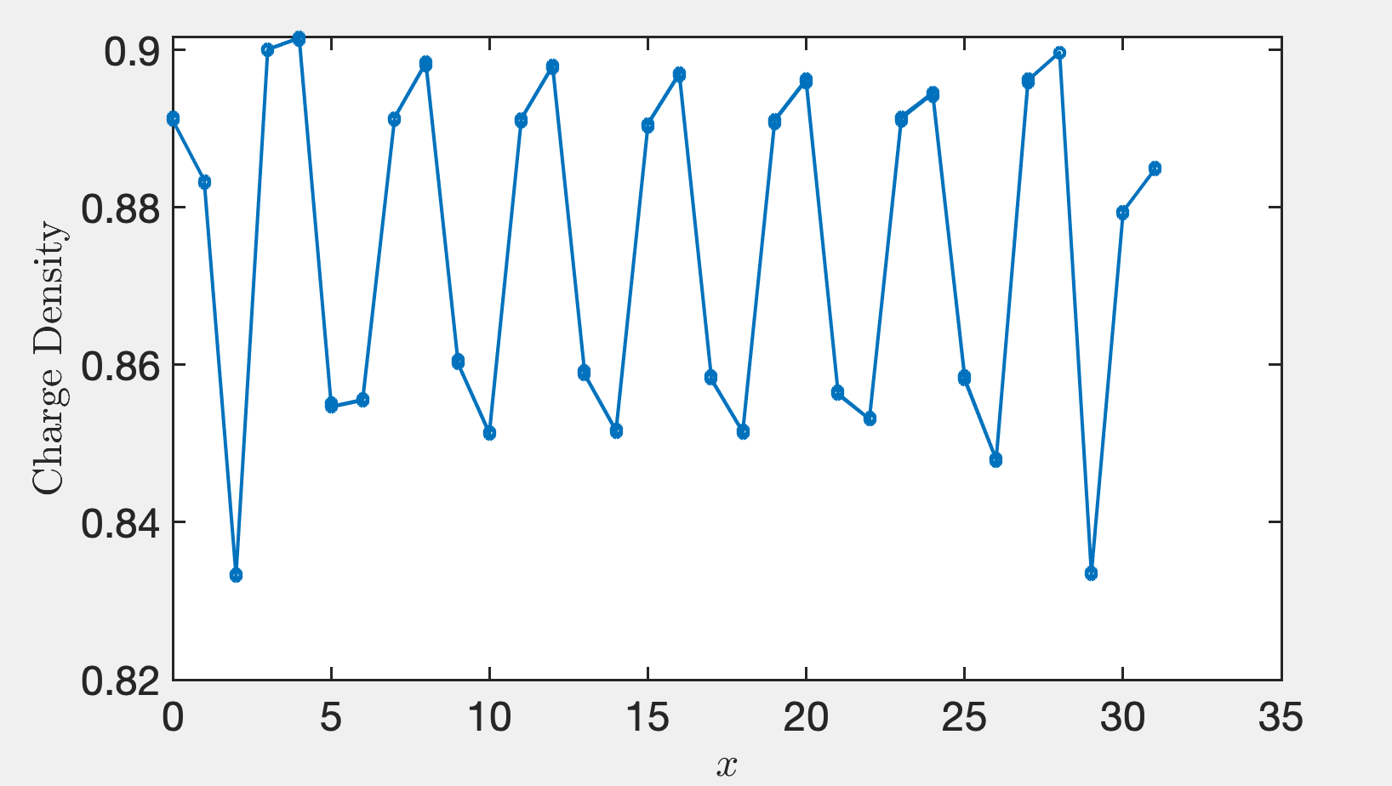
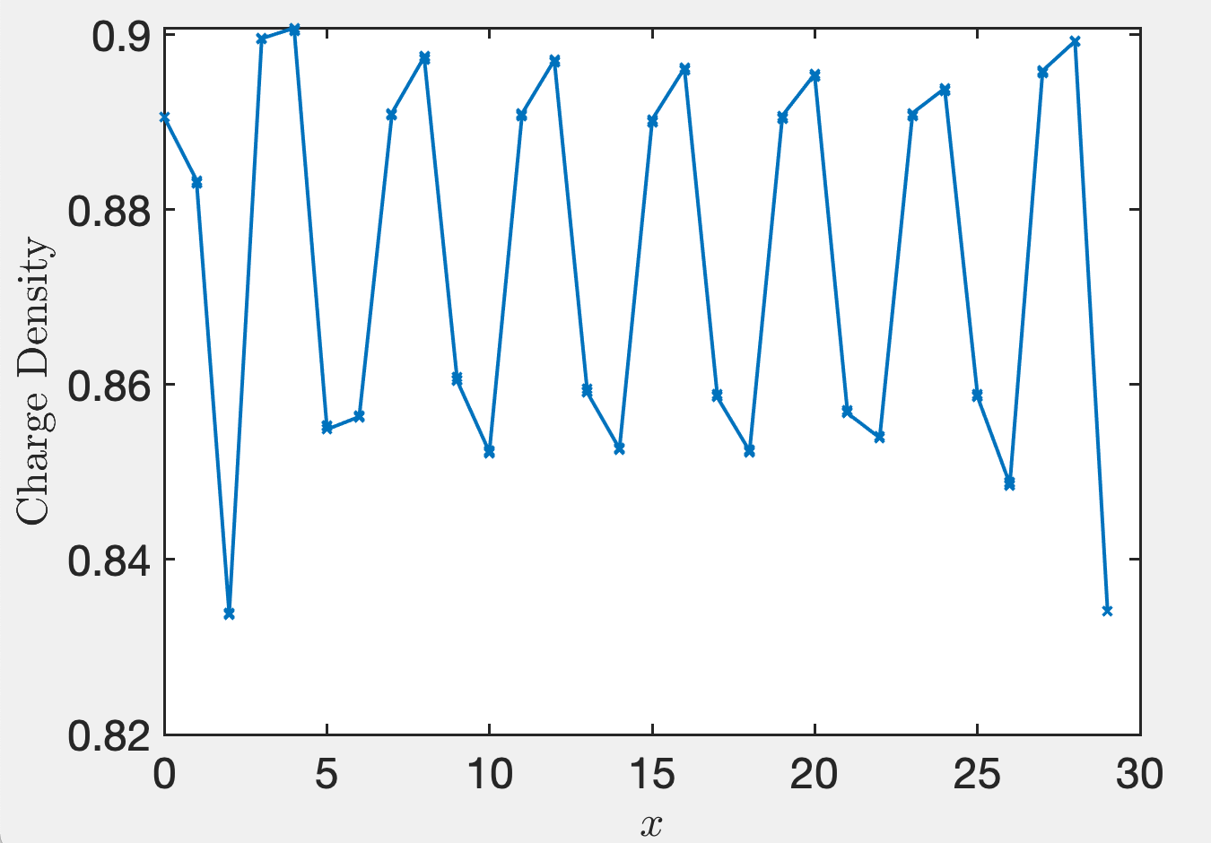
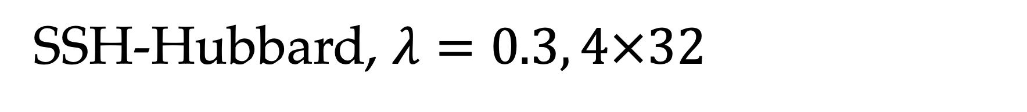
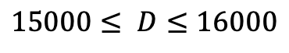

SSH-Hubbard, $λ=0.3, 4×32$
Shown in last week:
Sweep till Aug.22:
$$15000≤ D≤16000$$
$$14000≤D≤16000$$
Algorithm: single-site update
date: Aug, 5, 4pm
Latent reason why not reflection symmetry may come from sweep order

Slide 18


Extrapolation in last version note

Slide 19



SSH-Hubbard, $λ=0.3, 4×48$
Charge density pattern
D=8000, 10000, 12000 and extrapolation
D=8000, 10000, 12000,14000, 16000, and extrapolation

Slide 20



Power law fit
Friedel oscillation and charge correlation
Exponential fit

Slide 21



Kc=1.281

Slide 22



Exponential fit
Pair-pair correlation
Use all the data to extrapolate
Use D>=12000 and second-order polynomial to extrapolate

Slide 23


Two solid line is fitted by linear and quadratic extrapolation data respectively, with central charge 0.6861, and 1.0128

Slide 24


Holstein-Hubbard model
$$H=−t\sum_{\left\langle i,j\right\rangle ,σ}{\left(c_{iσ}^{†}c_{jσ}+h.c.\right)}+U\sum_{i}{n_{i↑}n_{i↓}}+ℏω\sum_{i}{b_{i}^{†}b_{i}}+g\sum_{i,σ}{\left[c_{iσ}^{†}c_{iσ}\left(b_{i}^{†}+b_{i}\right)+h.c.\right]}$$
$$U_{e−ph}=\frac{2g^{2}}{ℏω}$$

Slide 25





Holstein-Hubbard, $λ=0.2$
yy-bond correlation
$$D=14000$$
$$K_{sc} = 3.09 / ξ = 2.87$$
D=14000 strange state $E_{0}=−186.237(1)$。
D=14000 filled stripe $E_{0}=−186.267(1)$，
Whatever the wave length of pinning field is 4 or 8, the ground state is always filled stripe.

Slide 26










Holstein-Hubbard, $λ=0.3$
$$L_{x}=48$$
$$D=7000$$
$$E_{0}=−231.3893$$
$E_{0}=−347.344$ for strange state
$E_{0}=−347.496$for filled stripe state
$$L_{x}=32$$
$$E_{0}=−231.4426$$

Slide 27
Memo
11
12
18
1
2
3
13
14
4
5
6
16
15
7
8
9
17
18
10

Slide 28






SSH-Hubbard, $λ=0.1, 4×32$
$$D=13000$$
$$D=14000$$
State in last version note, as reference
$$E_{0}=−192.48705$$
This group calculation will give up
Aug. 21

Slide 29



SSH-Hubbard, $λ=0.2, 4×32$
$$D∼15000$$
-288.700
Aug, 29
We give up this group calculation and try $L_{x}=48$

